Slide 1
EDA and Prediction of International Coffee Prices with a Variety of Algorithms of Machine Learning
Simon Atehortua.
ID 501094927
December 5, 2022 |
1
Notes:
Hello everybody, My name is Simon Atehortua and my project is called Exploratory Data Analysis and Prediction of International Coffee Prices with a variety of algorithms of Machine learning.
In this project I will predict the Coffee prices from the ICO which means (International Coffee Organization). ICO sets the prices of coffee, collecting daily prices from the New York, Germany, and France futures exchanges.
now, this prices are expressed in US cents per pound of green coffee.
There are many factors that affect the prices either in one market or all of them, changing the prices on a daily basis, an example of this, is the cold fronts in Brazil during their winter, in this case the prices are affected as Brazil is the biggest coffee producer in the world

Slide 2

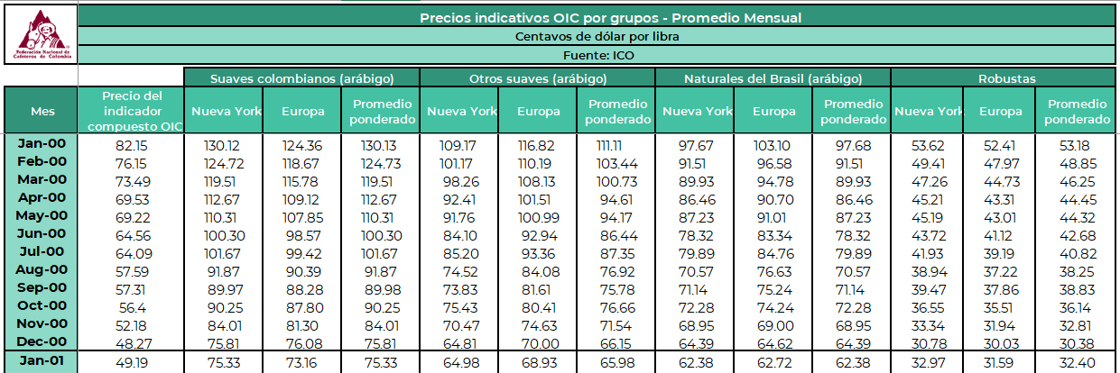
Data set from the National Federation of Colombian Coffee Growers website.
GitHub Link
https://github.com/montwa/Ryerson
Data Set Link
https://federaciondecafeteros.org/app/uploads/2020/01/Precios-%C3%A1rea-y-producci%C3%B3n-de-caf%C3%A9-3.xlsx
Excel Sheet: 6. Precio OIC Mensual
December 5, 2022 |
Notes:
For this project the data collected, comes straight from the National Federation of Coffee Growers of Colombia, or in spanish (Federacion Nacional de Cafeteros de Colombia).
This is the only entity that is allowed to export, and regulate the prices of coffee in the country of Colombia.
The dataset has 4 subdivision which are: Colombian Mild (Arabicas), Other Mild (Arabicas), Brazilian (Arabicas) and Robustas (which is mostly coffee from Vietnam and South-eastern Countries).
Each of the 4 divisions has 3 columns, one that is the market in the New York, another one that is the market in Europe and the last one that is the average between both
The dataset also contains a column with the month and another column with the ICO prices, which is my target column

Slide 3

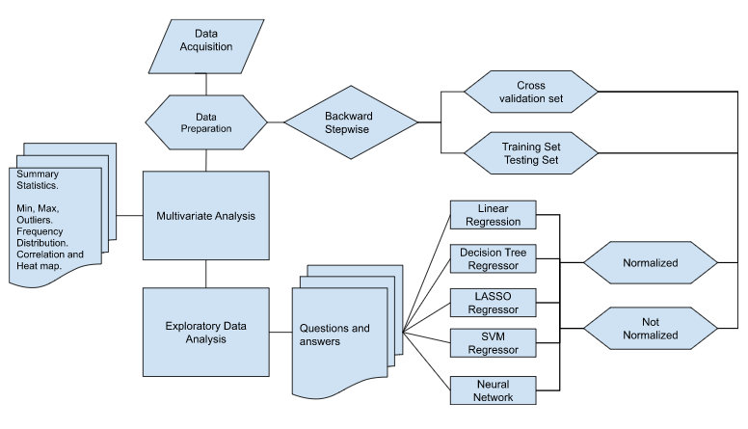
General Methodology
December 5, 2022 |
Notes:
After acquiring the dataset and preparing it, I extracted a summary of Statistics and did an Exploratory Data Analysis to look for possible questions that might arise and to see if there could be any information that could be of interest to the project
Data was used with 5 algorithms (Linear Regression, Decision Tree Regression, Lasso Regressor, SVM Regressor, and Neural Networks Algorithms.)
) and was tested with in 2 different ways, 1. Training and Testing Set, and then 2. Cross-Validation.
The data was normalized using the Standard Normalizer function from sklearn

Slide 4
Summary Statistics
There are 272 rows
The data does not have NA’s or empty cells
 | count | mean | std | min | 25% | 50% | 75% | Max
OIC_price | 272 | 113.633237 | 43.687941 | 41.17 | 88.5475 | 113.155682 | 133.130252 | 231.24
Colombia_ny | 272 | 153.333888 | 62.437782 | 58.92 | 112.94 | 144.413636 | 182.577237 | 319.63375
Colombia_europe | 272 | 148.409523 | 59.732402 | 57.72 | 111.6975 | 141.123636 | 178.760455 | 311.45
Colombia_average | 272 | 151.222932 | 61.156478 | 58.1 | 112.67 | 143.529552 | 179.0225 | 312.95
Other_ny | 272 | 145.099616 | 58.41441 | 51.95 | 108.72 | 141.896818 | 169.232857 | 303.59
Other_europe | 272 | 143.098234 | 55.916915 | 55.76 | 110.295 | 138.104348 | 165.942045 | 297.22
Other_average | 272 | 143.96633 | 56.927377 | 54.28 | 109.7125 | 140.704773 | 166.686126 | 300.12
Brazil_ny | 272 | 118.365112 | 49.732689 | 37.67 | 94.405 | 111.98 | 132.726023 | 271.39
Brazil_europe | 272 | 123.408718 | 51.170812 | 38.71 | 96.056883 | 117.983409 | 143.199599 | 273.43
Brazil_average | 272 | 121.959193 | 50.984818 | 38.63 | 95.605714 | 116.833333 | 140.72888 | 273.4
Robustas_ny | 272 | 79.670588 | 28.448193 | 21.25 | 57.895 | 84.680554 | 103.530147 | 126.3
Robustas_europe | 272 | 74.456376 | 26.5673 | 22.79 | 54.765 | 78.150682 | 97.329432 | 121.3
Robustas_average | 272 | 75.376692 | 26.767165 | 22.81 | 55.3475 | 79.203636 | 98.367841 | 121.98
Maximum Avg
Minimum Avg
December 5, 2022 |
Notes:
There are 272 rows, the dataset doesn’t have NA’s or empty rows, in general data is very clean
Note that the Colombian average maximum is almost 3 times as high as the price of the Robustas_average, which is predominantly from Vietnam, “Robustas has a high caffeine content (2% to 4%), so the flavor is not as pure as Arabica” (Roldan Perez et al., 2009,32).
“The quality of the Robusta coffee is uneven because of processing technology, drying equipment and post-harvest technological problems.
These cause the coffee beans to have a high humidity level, and won’t meet the required standard of color, quality, and more. This is the reason that Vietnam’s coffee price is lower than the world price.” (Roldan Perez et al., 2009,32).

Slide 5
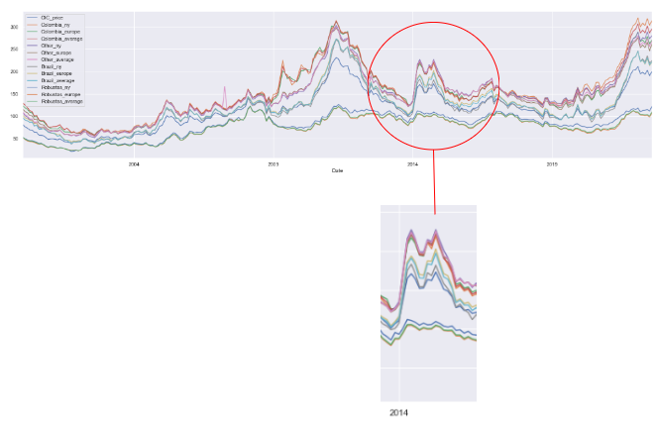
Coffee averages price distribution
“The daily price increased by over 50% between 30 January and 10 March, as the ongoing drought in Brazil
and uncertainty over the 2014/15 crop put upward pressure on prices” (ICO.ORG, 2014), this is particularly important
due that January 2014 was one of the hottest months in “Brazil, which produces nearly 40% of the world’s coffee” (Wile, 2014),
and lots of the crops were lost on this year
December 5, 2022 |
Notes:
In this slide we can see that there is sudden peak, the reason for this was the drought in Brazil and the uncertainty over 2014 and 2015 crops

Slide 6
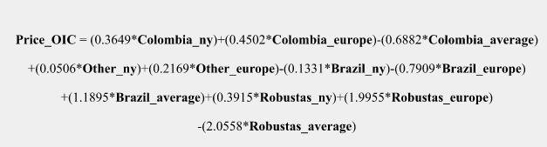
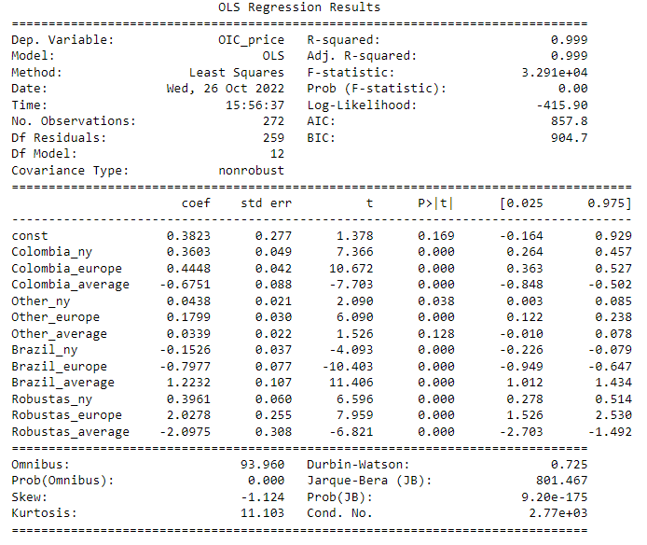
Features Selection and Backward Pairwise Relation
SL = 0.05
P-value < SL
The model is completed, keeping all the columns with the exemption of Columns: Other_average and Other_ny
Remove column if value is > 0.05
And re-do it again
December 5, 2022 |
Notes:
After doing an Exploratory Data Analysis, then I go into the regression part of the project
There are 14 columns in our data set, and in order to build a proper model to do regression, there will be a (Significance Level)) SL = 0.05
I obtain the p-values for each of the column using a backward stepwise regression, and if the p-values for the columns is > the Significance level, then that column will be discarded.
The computer will do this until I obtain a model where all the p-values are < the Significance Level.
The equation of the model can bee seen on this slide

Slide 7
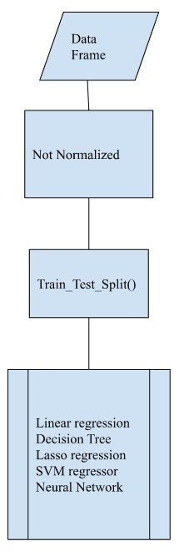
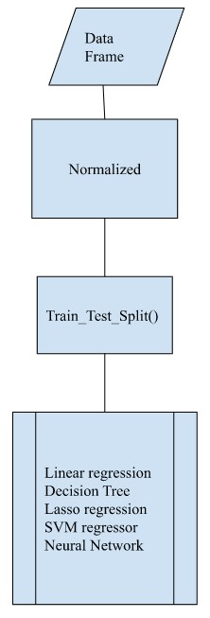
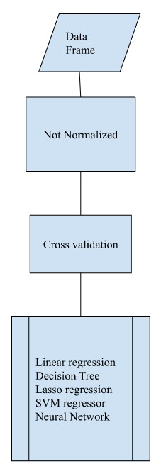
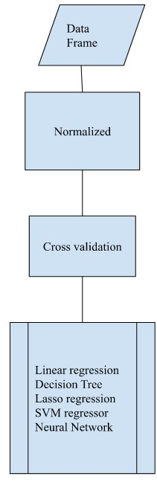
Train, Test, Split
Cross-Validation
Normalization
December 5, 2022 |
Notes:
This slide shows the methodology for the regression part of the project and how I approached each algorithm.
Is basically divided in 4 stages, 2 are normalized and 2 are not normalized, and for each one I have a cross validation and a Train, Test, Split.

Slide 8
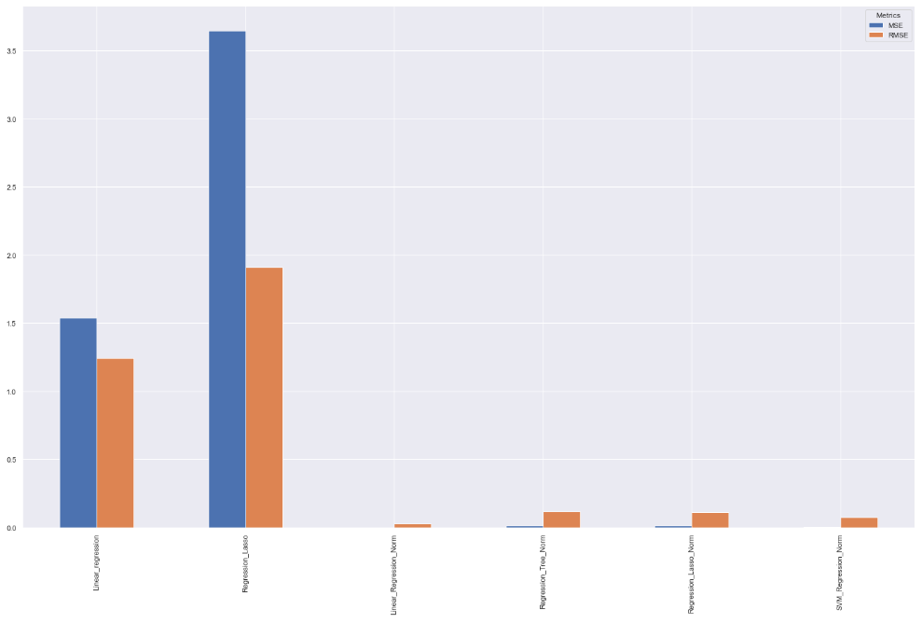
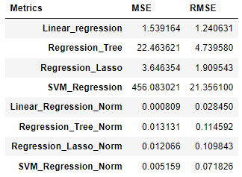
Normalized and Not Normalized on Train, Test, Split
SVM_Regression and Regression Tree have been dropped due to their high values.
Note the performance of the algorithms once they have been Normalized
Not Normalized
Normalized
December 5, 2022 |
Notes:
The best algorithm when having Training, Test, Split is Linear regression Normalized followed by Support Vector Machine Regression Normalized.
Note that SVM Regression and Regression Tree when they are not Normalized had to be dropped as they both have very high numbers, and once they have been normalized they will perform really well, specially SVM has a very good RMSE metric, so good that is the second best metric of all.
On the slide, with red, I have the normalized algorithms and in green the algorithms when they have not been normalized, and you can see the difference of the metrics, RMSE in my case as this is the metric that I am using to evaluate my models

Slide 9
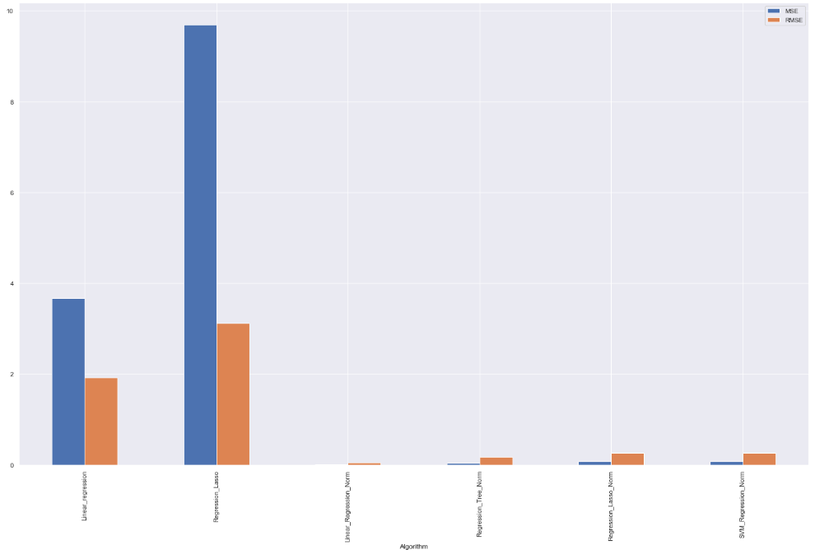
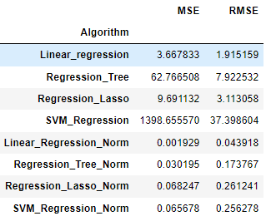
Normalized and Not Normalized on Cross-Validation
SVM_Regression and Regression Tree have been dropped due to their high values.
Note the performance of the algorithms once they have been Normalized
Not Normalized
Normalized
December 5, 2022 |
Notes:
The best algorithm when having Cross-validation set is Linear regression Normalized followed by Regression Tree Normalized.
Please look for SVM Regression and Regression Tree when they are not Normalized, their values are so high that I had to be dropped them in order for the have some visibility in the graph, and look at them again, once they have been normalized, Regression Tree has the 2nd best RMSE on the metrics.
Once again, on the slide, with red, I have the normalized algorithms and in green the algorithms when they have not been normalized, and you can see the difference of the metrics

Slide 10
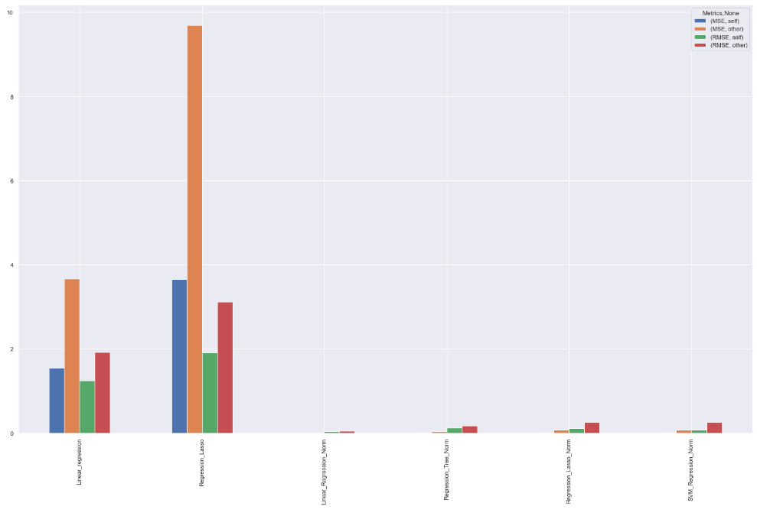
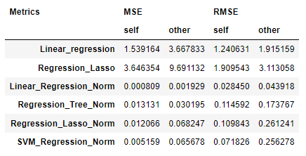
Comparation of Train and Test Set vs Cross-Validation
SVM_Regression and Regression Tree have been dropped due to their high values.
Note the performance of the algorithms once they have been Normalized
TT = Training Test Set
CV= Cross-Validation set
TT
CV
TT
CV
Not Normalized
Normalized
December 5, 2022 |
Notes:
Here, the most effective algorithm when doing Cross Validation, is the algorithm of Linear Regression Normalized, followed by Regression tree Normalized, note that SVM Regression and Regression Tree are very bad when not normalized, but Regression tree becomes really good once has been normalized.
Linear Regression Normalized has the lowest values above all. SVM_Regression, Regression_Tree and Regression_Lasso have been dropped as they are quite high in values and will make disappear the other values on the graph

Slide 11
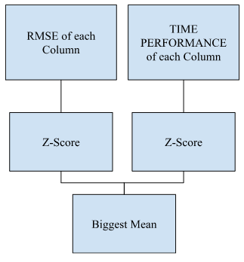
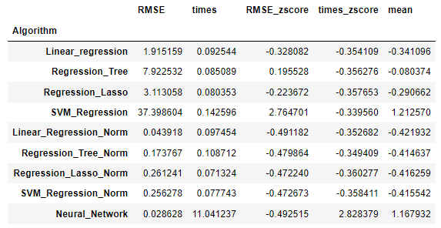
Timing and Selection of Algorithm
December 5, 2022 |
Notes:
To obtain the best algorithm, I’ll normalize the RMSE Column and Times Column with the Z-Score, then I obtain the mean of the Z-Score of each row, and from here I take the biggest mean and this is the Algorithm that I am going to select in this case,
The reason is that once I apply the Z-score, I am normalizing and bringing both columns to the same playing field or basically I will be able to comparing apples with apples
However, in this particular exercise, the execution times are so fast as we are talking about seconds and milliseconds, that is not worth to select my algorithm having in mind the execution time, I decided for this particular case just to select it by its metrics.
For all the algorithms that I have been using, Linear Regression Normalized has the best metrics or RMSE in my case, you can see as well that Neural Networks has even a better RMSE than Linear Regression
If I wasn’t selecting the algorithm based solemnly on RMSE but following the original idea of the z-scores, the algorithm that best performs is still Linear Regression Normalized, and the worst would be Neural Network

Slide 12
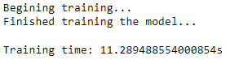
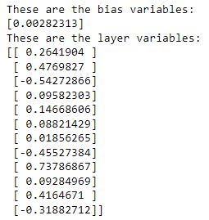
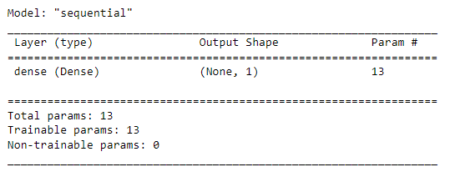
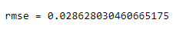
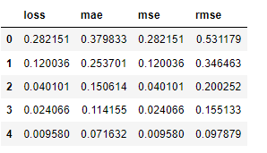
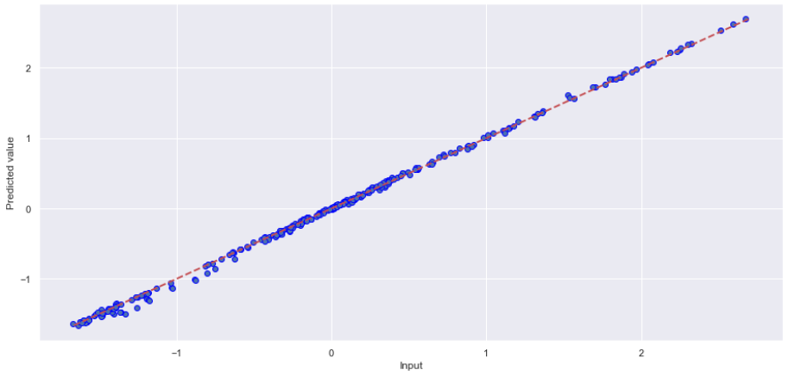
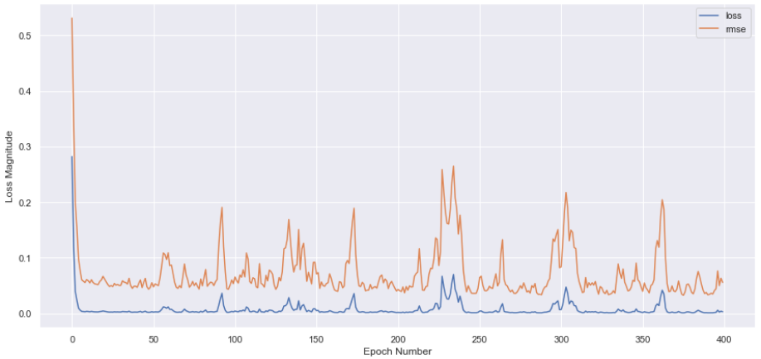
Neural Network
December 5, 2022 |
Notes:
Neural network is an exercise that I have done as a personal challenge and to gain knowledge on this interesting topic.
In order to do a neural Network, experts recommend normalizing the data and since it has been normalized then I will use the previously normalized data.
The first step is to obtain all the columns again and then Normalize it
Then the model is saved as a numpy with the 2 sets of data inputs = X and OIC_price = y
Then the number of input layers is 12 as there are 12 columns in the data set in order to obtain the variable that we need, in this case, is the column OIC_price, and this is the output layer, or basically what we want to predict.
A dense layer is needed (from all 12 neurons to one neuron, or basically from all 12 columns to the predicted column OIC_price)
Then I have to build a model for the layers, in this case, the Sequential (a sequence of layers stacked one after another) that is for a neural network that is not advanced.
I have to prepare the model to be trained (this is called a compiler), and I will use an optimizer called Adam, which allows the network to know how to use the bias and weights in an efficient way, so it learns, instead of unlearning ( gets better step by step).
The learning rate is 0.1, which indicates how to adjust the weights and bias (increasing in steps of 0.1)
To train the model, I choose epochs = 400, this is how many times I want it to loop (1 loop means checking all 272 entries), usually the more epochs the better training but only until a certain point.

